Slide 1

Project 1 social distancing: park crowds in nyc
Kirsten Fischl

Slide 2
Dataset
This data contains information about crowds breaking social distancing guidelines during Covid-19 in NYC parks.
(Original) N = 1,856 / (After cleaning) N = 1,168
8 columns of information about the incident including date/time, park area ID, park district, borough, patron count, playground, action taken by enforcement, and amenity in use
I wanted to explore this dataset to better understand where overcrowding is most likely to take place, what the trend of overcrowding looks like over time, and how effective park patrol is at managing crowds during the pandemic.
The dataset was downloaded from Open Data, a source for free public data published by New York City. This data specifically is from the Department of Parks and Recreation. It is updated daily and was first made public in early July.
Notes:
During the Covid-19 response, staff from NYC Parks and Maintenance and Operations division educated patrons on social distancing in addition to their regularly assigned tasks.
Each line of data describes a Park employee’s encounter with a group of people.

Slide 3
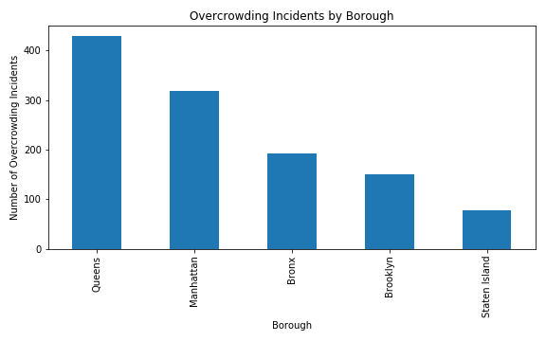
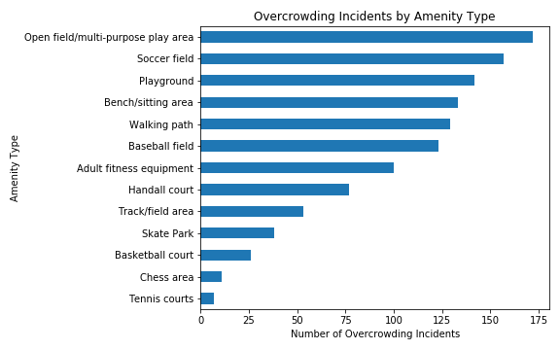
Where are crowds forming?
Parks in Queens have far more reports of crowds breaking social distancing guidelines than other boroughs, followed by Manhattan.
This may indicate that additional enforcement or stricter regulation is required to cut down on overcrowding.
Open areas were generally more likely to attract crowds, with open fields or multi-purpose play areas receiving the most reports.
Not surprisingly, areas dedicated to individual sports (such as tennis, chess, skating, track) did not experience overcrowding as often.
Notes:
Higher volumes in Queens and Manhattan may also mean that there is more enforcement already in place in these locations that are able to report a higher volume of crowds.

Slide 4
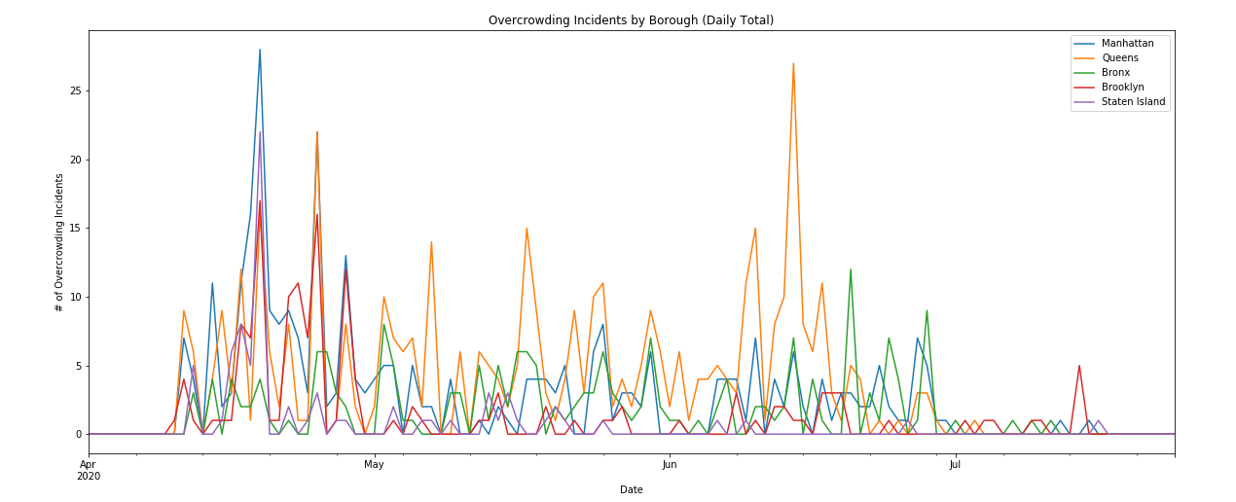
How has outdoor gathering changed over time?
When social distancing guidelines were first implemented NYC residents were far less likely to follow them. There were major spikes in reports of overcrowding in the month of April in all boroughs, with a major spike on April 19th.
Most boroughs saw a general downward trend in incidents since May, aside from Queens where a high volume of crowds continued to form through mid-June.
Crowds have been under control since the beginning of July for all boroughs.

Slide 5
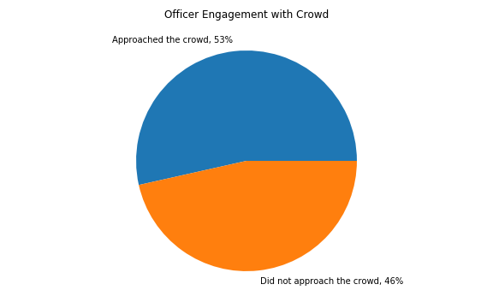
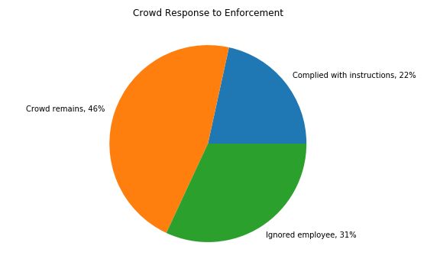
Are Park Officers Effective?
Park officers only approached crowds to inform them that they were breaking social distancing guidelines about half of the time (53%).
Nearly 8-in-10 crowds that broke guidelines remained despite an officer writing a report (77% total, sum of 46% not approached by the officer and 31% that ignored the employee)
Overall, Park Officers only disbanded 22% of crowds, indicating that their presence and command is not particularly strong.
Notes:
Park officers may not have approached crowds because they were at the park for other duties.

